Slide 1
Diagnosis of Acute Diseases in Villages and Smaller Towns Using AI
PIP2001 Capstone Project
Review-0
Batch Number:2021-25
Roll Number | Student Name
1. Chandrashekhar K S | 20211CSG0074
2. Bhuvneshwar C | 20211CSG0002
3. Manasa H A | 20211CSG0033
4. Praveen P | 20211CSG0016
Under the Supervision of,
Prof. Radhika Sreedharan
Professor / Associate Professor / Assistant Professor
School of Computer Science and Engineering
Presidency University
Name of the Program: Computer Science and Technology(CSG)
Name of the HoD: Dr. Saira Banu Athem
Name of the Program Project Coordinator:
Name of the School Project Coordinators: Dr. Sampath A K / Dr. Abdul Khadar A / Mr. Md Ziaur Rahman

Slide 2
Content
Problem Statement
Analysis of Problem Statement
Timeline of the Project
References

Slide 3
Problem Statement Number: PSCS46
Organization: Max Healthcare
Category (Hardware / Software / Both) : Software
Problem Description:
Supply of doctors is limited in India especially in smaller towns and villages making provision of healthcare difficult to a large number of people. Telemedicine and other solutions in the past have also struggled to scale up due to this problem. Now in the age of digital assistants like Google and Alexa, can we create artificial intelligence based "doctor" that can diagnose everyday acute diseases like common cold, flu, etc, based on simple questions?
Difficulty Level: Complicated

Slide 4
Analysis of Problem Statement
Technology Stack Components:
Machine Learning Algorithms (Supervised Learning, Deep Learning)
AI Frameworks (TensorFlow, PyTorch)
Data Sources (Electronic Health Records, Medical Datasets)
Frontend: Web/App Interface (React, Flutter)
Backend: Python, Flask/Django

Slide 5
Analysis of Problem Statement (contd...)
Software and Requirements:
AI/ML Platforms (TensorFlow, Keras, PyTorch)
Web/App Development Tools (HTML, CSS, JavaScript, Flutter)
Database (SQL, MongoDB)
Hardware Requirements:
Cloud Computing Services (AWS, Google Cloud)
Basic Computers or Mobile Devices for testing

Slide 6
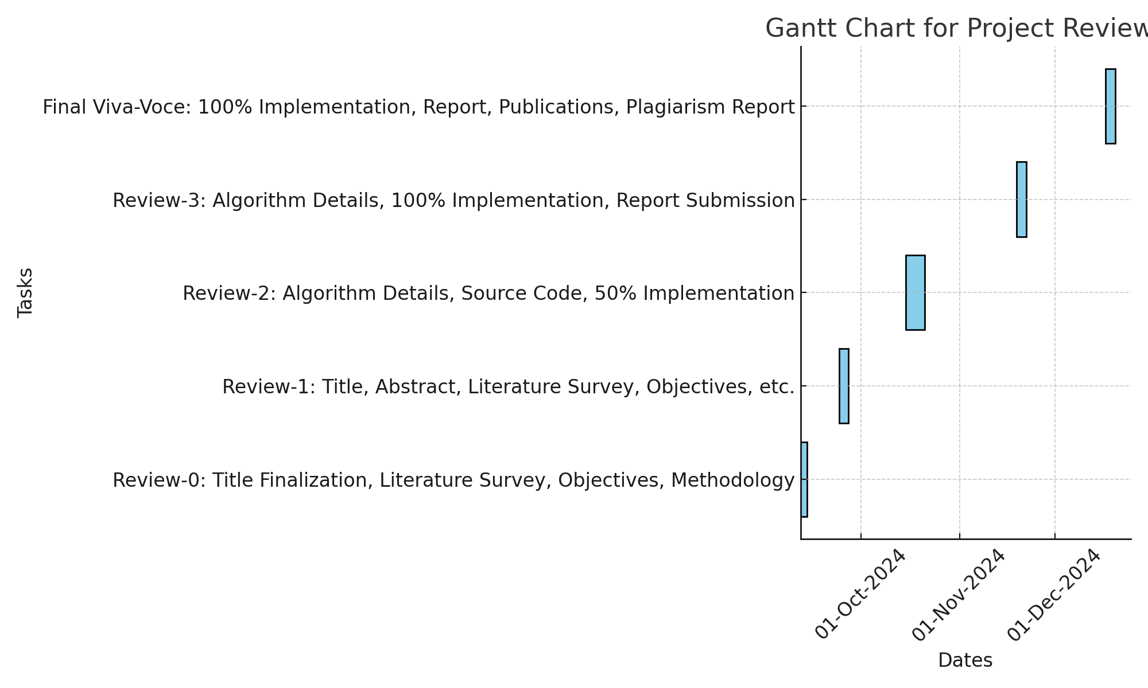
Timeline of the Project (Gantt Chart)

Slide 7
References (IEEE Paper format)
Smith, J., & Doe, A. (2023). AI in Healthcare: A comprehensive review. Journal of Medical AI, 12(4), 123-130.Johnson, P. (2022).
Machine Learning Techniques for Disease Prediction. AI & Health Journal, 10(3), 321-334.

Slide 8


